Slide 1

HR Employees Details Dashboard
Doan Thi Van Khanh
Sep 7th 2024

Slide 2
1. Data Collection
Download dummy dataset from web training. Link
Load data to PBI by using Enter Data function.
2. Data Cleaning
Review and validate dataset for accuracy and completeness.
Implement data normalization techniques to ensure consistency and uniformity across all datasets
3. Data Visualization
Use PBI to generate interactive and insightful visual representations of HR metrics.
Identify and present key performance indicators related to employee satisfaction and other relevant HR insights.
Dashboard overview

Slide 3
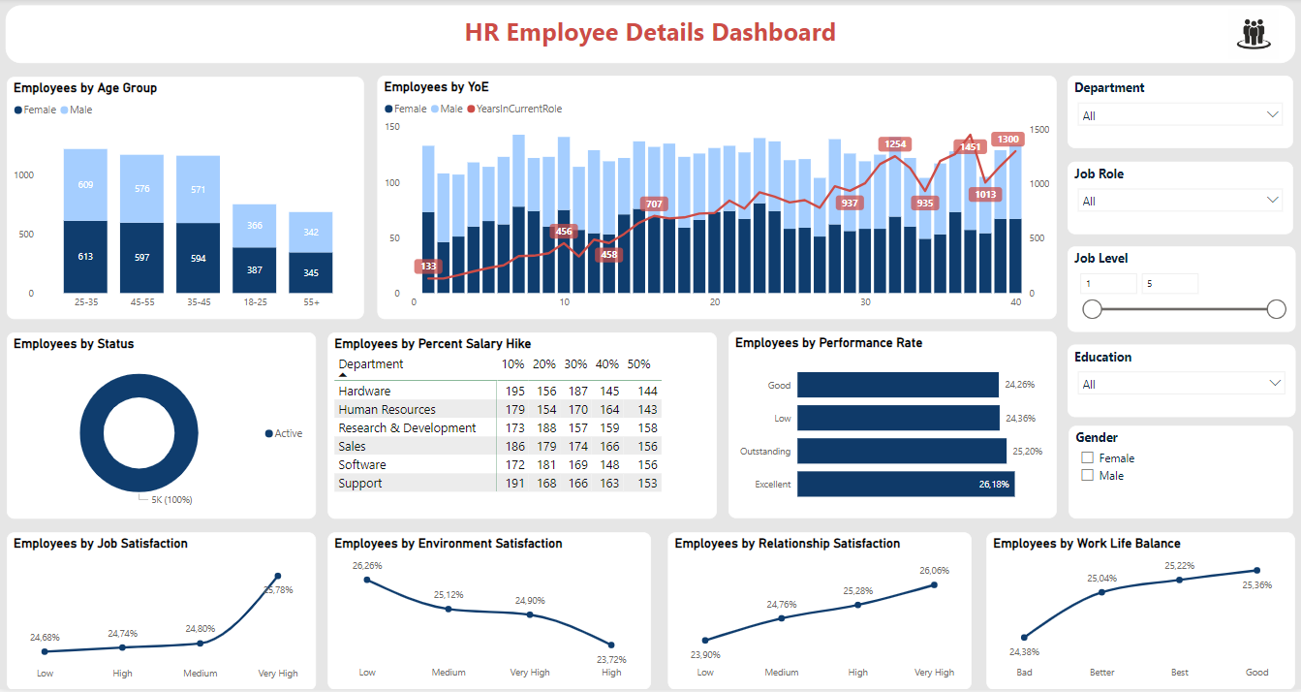
Dashboard page
Page is filtered by 5 categories:
Department
Job role
Jo level
Education
Gender

Slide 4
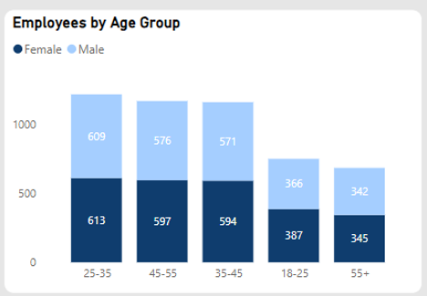
Stacked column chart : Employees by Age Group
The collective count of female employees stands at 2536, surpassing that of male employees, which stands at 2464.
Group 25-35 years old female employees constitute 1.62% of the entire workforce.
The average number of female employees, at 63.40, exceeds that of male employees, which averages at 61.60.
The most significant disparity in employee count between females and males was observed within the 35-45 age group, with females exceeding males by 23 employees.

Slide 5
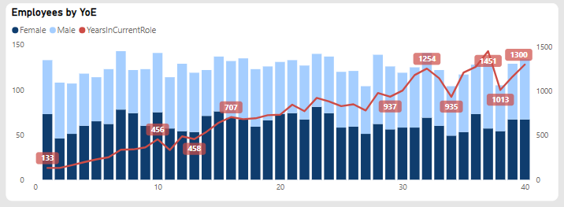
Line and Stacked column chart : Employees by YoE
This chart illustrates the distribution of employees based on their years of experience in relation to the duration of their current role, segmented by gender.
The tenure in the current position correlates with the employees' years of experience.

Slide 6
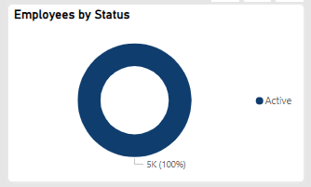
Donut chart : Employees by Status
This donut chart visualizes the distribution of employees based on their current status within the company. All employees, accounting for 100%, are currently active in their roles.

Slide 7
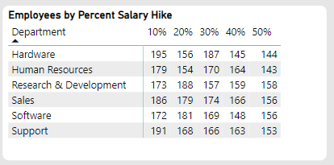
Matrix table : Employees by Percent Salary Hike
This table presents the distribution of employees based on the percentage of salary increase, categorized by department.

Slide 8
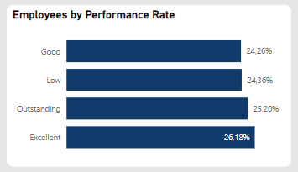
Stacked bar chart : Employees by Performance Rate
This chart presents the aggregated performance ratings of employees as measured by the tracked key performance indicators.
There is a significant prevalence of low performance, with approximately 25%, indicating the need for improvement.

Slide 9
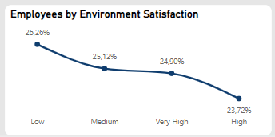
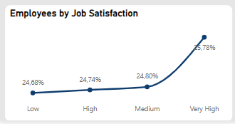
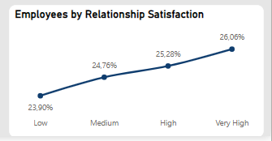
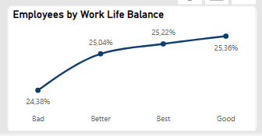
Line chart : Employees by Satisfaction
These line charts depict the employee satisfaction indicators.
Overall, most employees are dissatisfied with the work environment but highly satisfied with their job and internal relationships within the company.
However, the work-life balance indicator reveals an overall unfavorable rating, as the variance between poor scores and other ratings is minimal.

